Slide 1

空白演示
English 118: GRP Presentation
Student: Zhan Yu
Instructor: T. Nuckolls
单击输入您的封面副标题
Topic: Teenage Criminal Behavior

Slide 2
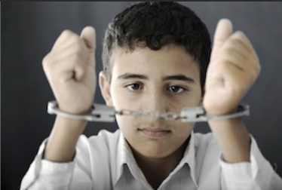
空白演示
RQ: How can society best reduce rate of juvenile delinquency
单击输入您的封面副标题

Slide 3
空白演示
Thesis: Providing teenager with a better family environment is potentially the best solution for society to reduce teenage crime rate, which is better than promoting school education and having strong bond with good peers.
单击输入您的封面副标题
I. Promotion school education is an common solution.
II. having relationship with better peers is a better one.
III.Improving family environment is the most effective measure.

Slide 4

空白演示
Backgroud information
Severe problems to society and individuals
40% keeping arms, stealing, and drug addiction
Labelled as “deliquent family”
单击输入您的封面副标题

Slide 5

空白演示
Point 1: Promoting school eduction is a common solution
A. Provide healthy living habit and information.
B. Chance to engage in extra-curricular activities
C. Live and contact with successful people.
单击输入您的封面副标题

Slide 6
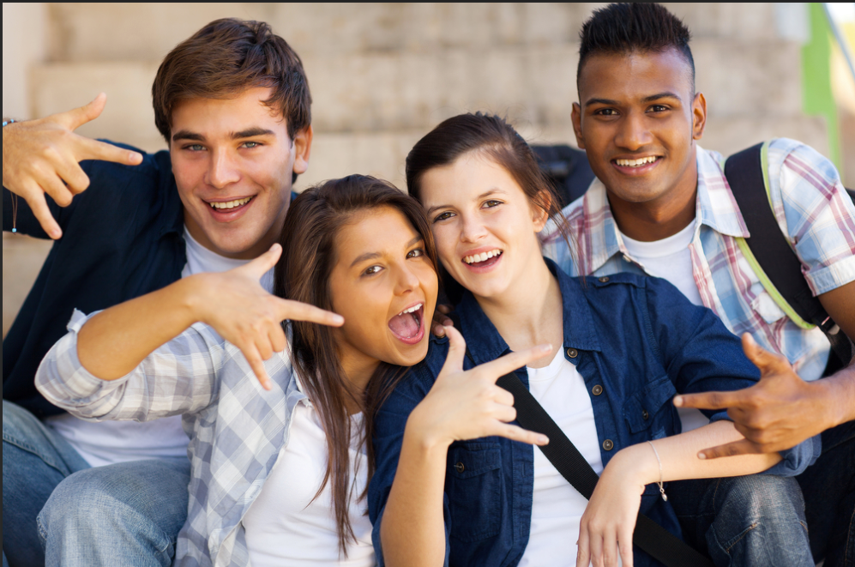
空白演示
Point 2: Stressing healthy peer interaction is a better solution.
A. Long time interacting with peers -- deeply influence
B. School -- place gathers peers
单击输入您的封面副标题

Slide 7
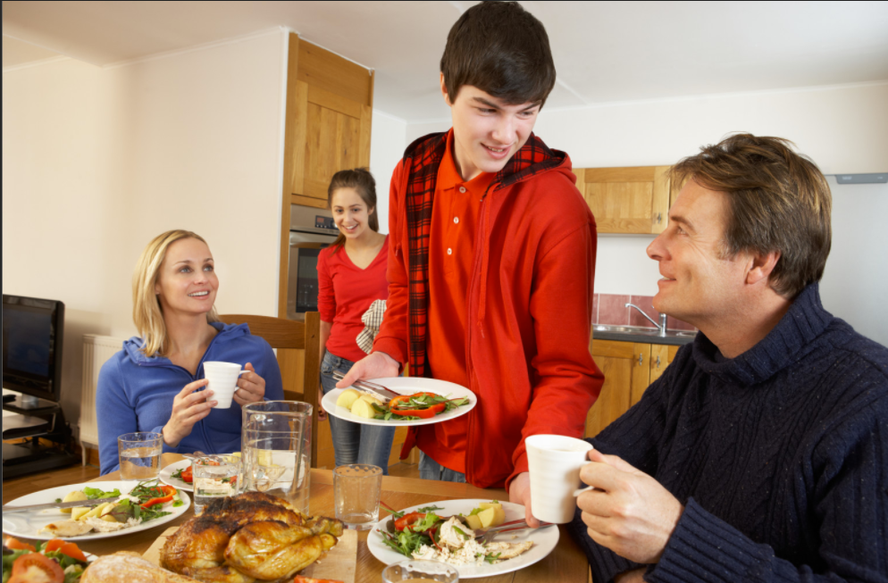
空白演示
Point 3: Improving teenager's family environment is potentially the most effective solution.
A. Intact family ensures teenager's better personal development.
B. Guide teenager to have better peer groups.
单击输入您的封面副标题

Slide 8

空白演示
Conclusion: Society should reduce teenage crime rate by ensuring better family environment for teenagers due to its high efficiency.
单击输入您的封面副标题

Slide 9

空白演示
单击输入您的封面副标题

